Slide 1
FUELS AND COMBUSTION
Department of Mechanical Engineering
S. V. National Institute of Technology

Slide 2
Topics: Introduction to Fuels, Properties of Fuel oil, Coal and Gas, Storage, handling and preparation of fuels, Principles of Combustion, Combustion of Oil, Coal, and Gas
Types of fuels -liquid, solid and gaseous fuels are available for firing in boilers, furnaces and other combustion equipments.
The selection of right type of fuel depends on various factors such as availability, storage, handling, pollution and landed cost of fuel.
The knowledge of the fuel properties helps in selecting the right fuel for the right purpose and efficient use of the fuel.

Slide 3
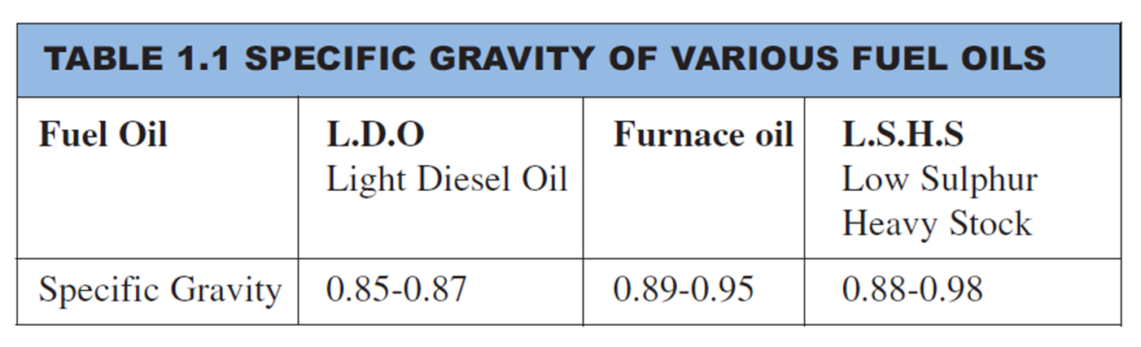
Properties of Liquid Fuels:
Liquid fuels like furnace oil and LSHS are predominantly used in industrial application.
Density:
Ratio of the mass of the fuel to the volume of the fuel at a reference temperature of 15°C and is measured by an instrument called hydrometer. Unit is kg/m³.
Specific gravity:
Ratio of the weight of a given volume of oil to the weight of the same volume of water at a given temperature. The density of fuel, relative to water, is called specific gravity.
The measurement of specific gravity is generally made by a hydrometer

Slide 4
Viscosity:
The most important characteristic in the storage and use of fuel oil.
Measure of its internal resistance to flow. Viscosity is depends on temperature and it decreases as the temperature increases.
Viscosity is measured in Stokes /Centistokes. Sometimes viscosity is also quoted in Engler, Saybolt or Redwood. Each type of oil has its own temperature - viscosity relationship.
The measurement of viscosity is made with an instrument called Viscometer.
It influences the degree of pre-heat required for handling, storage and satisfactory atomization.
If the oil is too viscous, it may become difficult to pump, hard to light the burner, and tough to operate.
Poor atomization may result in the formation of carbon deposits on the burner tips or on the walls. Therefore pre-heating is necessary for proper atomization.

Slide 5
Flash Point:
The flash point of a fuel is the lowest temperature at which the fuel can be heated so that the vapour gives off flashes momentarily when an open flame is passed over it. Flash point for furnace oil is 66°C.
Pour Point:
The pour point of a fuel is the lowest temperature at which it will pour or flow when cooled under prescribed conditions. It is a very rough indication of the lowest temperature at which fuel oil is readily pumpable.
Specific Heat:
The amount of kCals needed to raise the temperature of 1 kg of oil by 1°C.
The unit of specific heat is kCal/kg°C.
It varies from 0.22 to 0.28 depending on the oil specific gravity.
The specific heat determines how much steam or electrical energy it takes to heat oil to a desired temperature.
Light oils have a low specific heat, whereas heavier oils have a higher specific heat.

Slide 6
Calorific Value:
The calorific value is the measurement of heat or energy produced, and is measured either as Gross Calorific Value (GCV)or Net Calorific Value (NCV). The difference being the latent heat of condensation of the water vapour produced during the combustion process.
GCV assumes all vapour produced during the combustion process is fully condensed.
NCV assumes the water leaves with the combustion products without fully being condensed. Fuels should be compared based on the NCV.
The calorific value of coal varies considerably depending on the ash, moisture content and the type of coal while calorific value of fuel oils are much more consistent.
Fuel Oil GCV (kCal/kg)
Kerosene - 11,100
Diesel Oil - 10,800
L.D.O - 10,700
Furnace Oil - 10,500
LSHS - 10,600

Slide 7
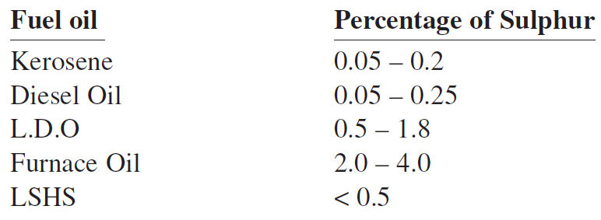
Sulphur:
The amount of sulphur in the fuel oil depends mainly on the source of the crude oil and to a lesser extent on the refining process.
Normal sulfur content for the residual fuel oil (furnace oil) is in order of 2-4 %.
As per the latest status : India was observed maximum producer of sulfur (Dated 20/08/2019)
The main disadvantage of sulphur is the risk of corrosion by sulphuric acid formed during and after combustion, and condensing in cool parts of the chimney or stack, air pre heater and economizer.

Slide 8
Ash Content:
Related to the inorganic material in the fuel oil. The ash levels of distillate fuels are negligible.
Residual fuels have more of the ash-forming constituents. These salts may be compounds of sodium, vanadium, calcium, magnesium, silicon, iron, aluminum, nickel, etc.
Typically, the ash value is in the range 0.03–0.07%. Excessive ash in liquid fuels can cause fouling deposits in the combustion equipment. Ash has erosive effect on the burner tips, causes damage to the refractories at high temperatures and gives rise to high temperature corrosion and fouling of equipment.
Carbon Residue:
Carbon residue indicates the tendency of oil to deposit a carbonaceous solid residue on a hot surface, such as a burner or injection nozzle, when its vaporizable constituents evaporate.
Residual oil contain carbon residue ranging from 1 percent or more.

Slide 9
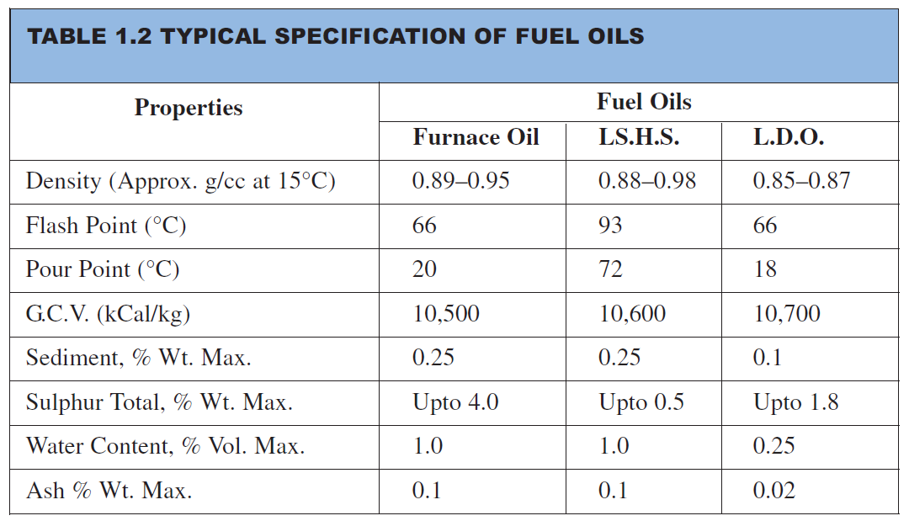
Water Content:
Water content of furnace oil when supplied is normally very low as the product at refinery site is handled hot and maximum limit of 1% is specified in the standard.
Water may be present in free or emulsified form and can cause damage to the inside furnace surfaces during combustion especially if it contains dissolved salts.
It can also cause spluttering of the flame at the burner tip, possibly extinguishing the flame and reducing the flame temperature or lengthening the flame.

Slide 10
LOSS OF EVEN ONE DROP OF OIL EVERY SECOND CAN COST YOU OVER 4000 LITRES A YEAR.
Storage of Fuel Oil:
It can be potentially hazardous to store furnace oil in barrels. A better practice is to store it in cylindrical tanks, either above or below the ground. Furnace oil, that is delivered, may contain dust, water and other contaminants.
The sizing of storage tank facility is very important. Industrial heating fuel storage tanks are generally vertical mild steel tanks mounted above ground.
It is prudent for safety and environmental reasons to build bund walls around tanks to contain accidental spillages.
Certain amount of settlement of solids & sludge will occur in tanks over time, cleaning should be carried out at regular intervals-annually for heavy fuels and every two years for light fuels.
Fuel oil should be free from possible contaminants such as dirt, sludge and water before it is fed to the combustion system.

Slide 11
Pumping:
Heavy fuel oils are best pumped using positive displacement pumps, as they are able to get fuel moving when it is cold. A circulation gear pump running on LDO should give between 7000-10000 hours of service. Diaphragm pumps have a shorter service life, but are easier and less expensive to repair.
A centrifugal pump is not recommended, because as the oil viscosity increases, the efficiency of the pump drops sharply and the required HP increases. Light fuels are best pumped with centrifugal or turbine pumps. When higher pressures are required, piston or diaphragm pumps should be used.
At low ambient temperatures (below 25°C), furnace oil is not easily pumpable.
To preheat the oil is accomplished (a) the entire tank may be preheated. In this form of bulk heating, steam coils are placed at the bottom of the tank, which is fully insulated(b) the oil can be heated as it flows out with an outflow heater. To reduce steam requirements, it is advisable to insulate tanks where bulk heating is used.

Slide 12
Temperature Control:
Thermostatic temperature control of the oil is necessary to prevent overheating, especially when oil flow is reduced or stopped. This is particularly important for electric heaters, since oil may get carbonized when there is no flow and the heater is on.
Thermostats should be provided at a region where the oil flows freely into the suction pipe. The temperature at which oil can readily be pumped depends on the grade of oil being handled. Oil should never be stored at a temperature above that necessary for pumping as this leads to higher energy consumption.

Slide 13
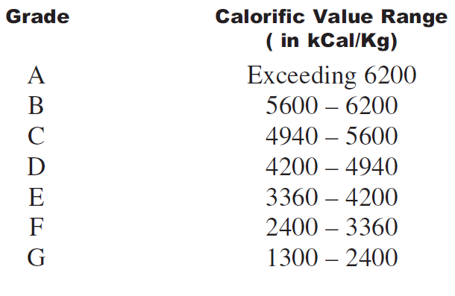
Properties of Coal:
Three major types - Anthracite, Bituminous, and Lignite.
Further classified as semi-anthracite, semi-bituminous, and sub-bituminous.
Anthracite is the oldest coal from geological perspective. It is a hard coal composed mainly of carbon with little volatile content and practically no moisture.
Lignite is the youngest coal from geological perspective. It is a soft coal composed mainly of volatile matter and moisture content with low fixed carbon.
Fixed carbon refers to carbon in its free state, not combined with other elements. Volatile matter refers to those combustible constituents of coal that vaporize when coal is heated.
The common coals used in Indian industry are bituminous and sub-bituminous coal
Normally D, E and F coal grades are available to Indian Industry

Slide 14
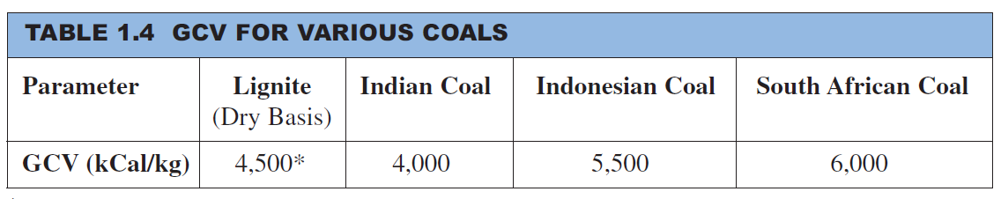
Physical Properties
Heating Value:
The heating value of coal varies from coal field to coal field. The typical GCVs for various coals are given in the Table.
Analysis of Coal:
Two methods: (1) Ultimate analysis (2) Proximate analysis.
The ultimate analysis determines all coal component elements, solid or gaseous.
The ultimate analysis is determined in a properly equipped laboratory by a skilled chemist.
The proximate analysis determines only the fixed carbon, volatile matter, moisture and ash percentages.,
Proximate analysis can be determined with a simple apparatus. It may be noted that proximate has no connection with the word “approximate”.

Slide 15
Measurement of Moisture:
Determination of moisture is carried out by placing a sample of powdered raw coal of size 200-micron size in an uncovered crucible and it is placed in the oven kept at 108±2°C along with the lid.
Then the sample is cooled to room temperature and weighed again. The loss in weight represents moisture.
Measurement of Volatile Matter:
Fresh sample of crushed coal is weighed, placed in a covered crucible, & heated in a furnace at 900 ± 15°C.
Methodologies including that for carbon and ash, refer to IS 1350 part I:1984, part III, IV.
The sample is cooled and weighed. Loss of weight represents moisture and volatile matter. The remainder is coke (fixed carbon and ash).
Measurement of Carbon and Ash
The cover from the crucible used in the last test is removed and the crucible is heated over the Bunsen burner until all the carbon is burned. The residue is weighed, which is the incombustible ash.
The difference in weight from the previous weighing is the fixed carbon. In actual practice Fixed Carbon or FC derived by subtracting from 100 the value of moisture, volatile matter and ash.

Slide 16
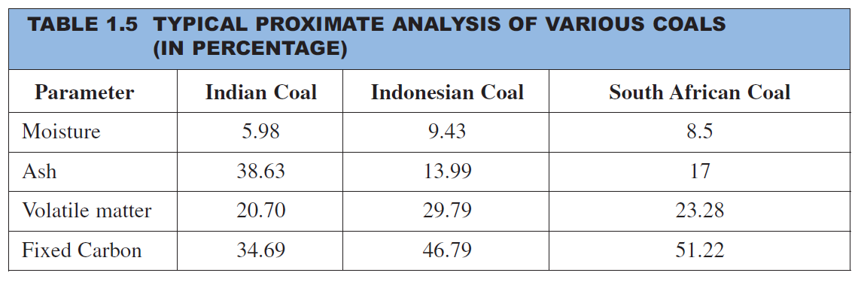
Proximate Analysis:
Proximate analysis indicates the percentage by weight of the Fixed Carbon, Volatiles, Ash, and Moisture Content in coal. The amounts of fixed carbon and volatile combustible matter directly contribute to the heating value of coal.
Fixed carbon acts as a main heat generator during burning.
High volatile matter content indicates easy ignition of fuel. The ash content is important in the design of the furnace grate, combustion volume, pollution control equipment and ash handling systems of a furnace.

Slide 17
Significance of Various Parameters in Proximate Analysis
(a) Fixed carbon:
Fixed carbon is the solid fuel left in the furnace after volatile matter is distilled off. It consists mostly of carbon but also contains some hydrogen, oxygen, sulphur and nitrogen not driven off with the gases. Fixed carbon gives a rough estimate of heating value of coal.
(b) Volatile Matter:
Volatile matters are the methane, hydrocarbons, hydrogen and carbon monoxide, and incombustible gases like carbon dioxide and nitrogen found in coal. Thus the volatile matter is an index of the gaseous fuels present.
Typical range of volatile matter is 20 to 35%.
Proportionately increases flame length, and helps in easier ignition of coal.
Sets minimum limit on the furnace height and volume.
Influences secondary air requirement and distribution aspects.
Influences secondary oil support

Slide 18
(c) Ash Content:
Ash is an impurity that will not burn.
Typical range is 5 to 40%
Ash Reduces handling and burning capacity.
Increases handling costs.
Affects combustion efficiency and boiler efficiency
Causes clinkering and slagging.
(d) Moisture Content:
Moisture in coal must be transported, handled and stored. Since it replaces combustible matter, it decreases the heat content per kg of coal.
Typical range is 0.5 to 10%
Increases heat loss, due to evaporation and superheating of vapour
Helps, to a limit, in binding fines.
Aids radiation heat transfer.
(e) Sulphur Content:
Typical range is 0.5 to 0.8% normally.
• Affects clinkering and slagging tendencies
• Corrodes chimney and other equipment i.e., Air heaters
& economizers
• Limits exit flue gas temperature.

Slide 19
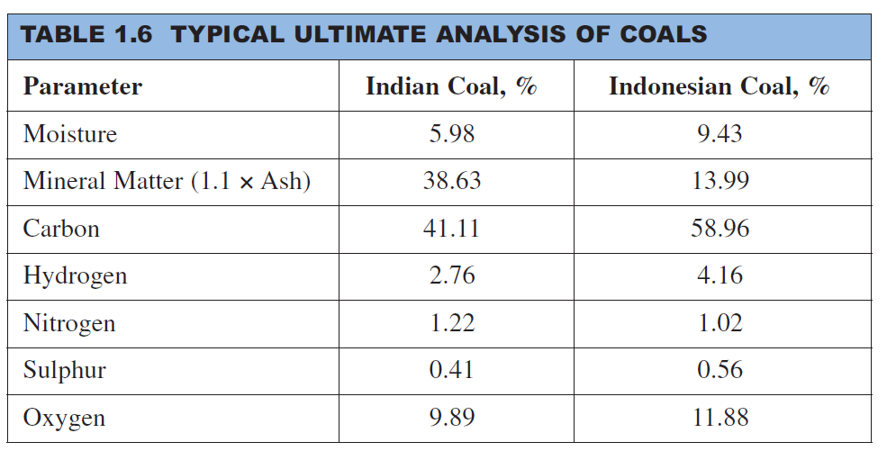
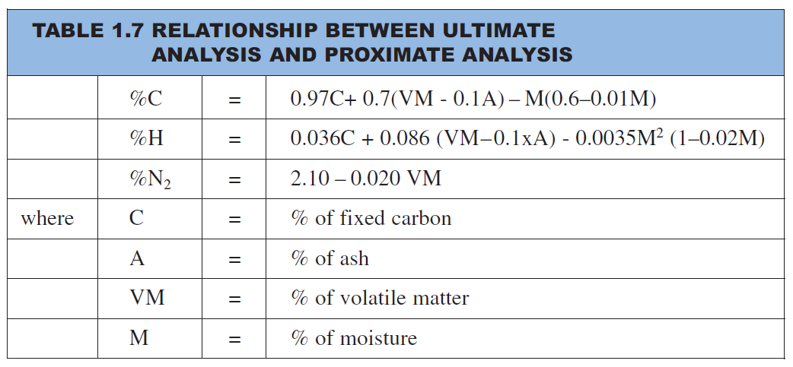
Chemical Properties:
Ultimate Analysis:
The ultimate analysis indicates the various elemental chemical constituents such as Carbon, Hydrogen, Oxygen, Sulphur, etc.
It is useful in determining the quantity of air required for combustion and volume and composition of combustion gases.
This information is required for the calculation of flame temperature and the flue duct design etc.
Note: The shown equation is valid for coal containing greater than 15% Moisture content.

Slide 20
In process Industry, modes of coal handling range from manual to conveyor systems. It would be advisable to minimize the handling of coal so that further generation of fines and segregation effects are reduced.
Preparation of Coal:
Preparation of coal for boiler is an important step for achieving good combustion.
Large and irregular lumps of coal may cause the following problems:
1. Poor combustion conditions and inadequate furnace temperature.
2. Higher excess air resulting in higher stack loss.
3. Increase of unburnt in the ash.
4. Low thermal efficiency.

Slide 21
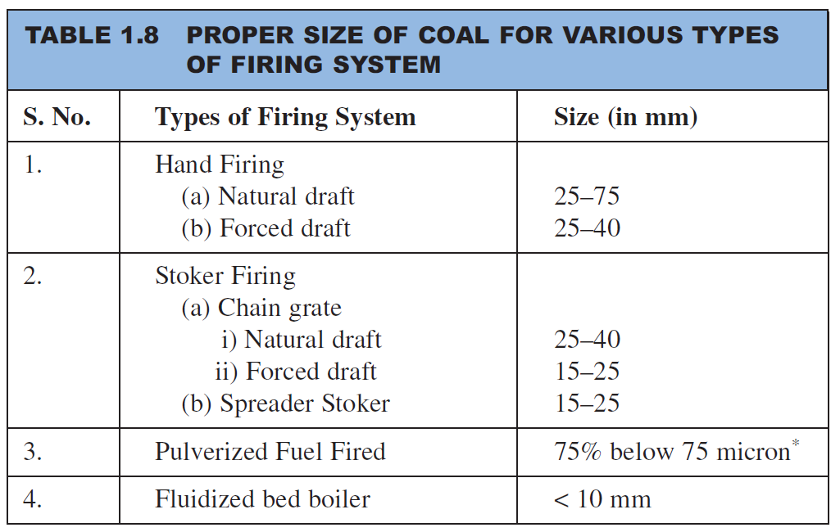
Sizing of Coal:
Proper coal sizing, with specific relevance to the type of firing system, helps towards even burning, reduced ash losses and better combustion efficiency.
Pre-crushed coal can be economical for smaller units, especially those which are stoker fired. In a coal handling system, crushing is limited to a top size of 6 or 4 mm.
The devices most commonly used for crushing are the rotary breaker, the roll crusher and the hammer mill.

Slide 22
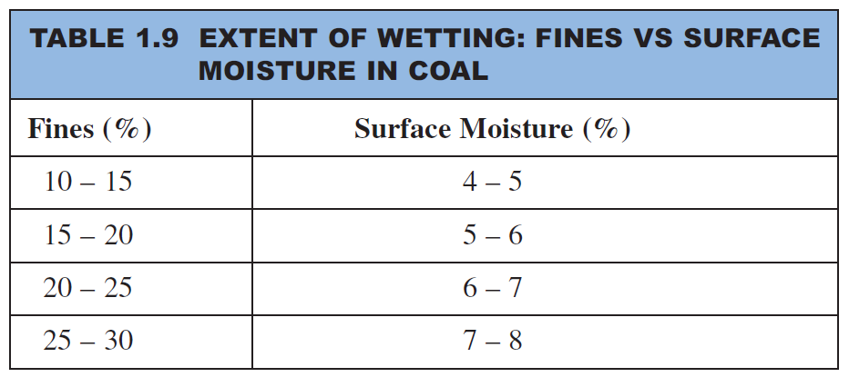
(b) Conditioning of Coal:
The fines in coal present problems in combustion on account of segregation effects.
Segregation of fines from larger coal pieces can be reduced to a great extent by conditioning coal with water.
Water helps fine particles to stick to the bigger lumps due to surface tension of the moisture, thus stopping fines from falling through grate bars or being carried away by the furnace draft. While tempering the coal, care should be taken to ensure that moisture addition is uniform and preferably done in a moving or falling stream of coal.
If the percentage of fines in the coal is very high, wetting of coal can decrease the percentage of unburnt carbon and the excess air level required to be supplied for combustion.

Slide 23
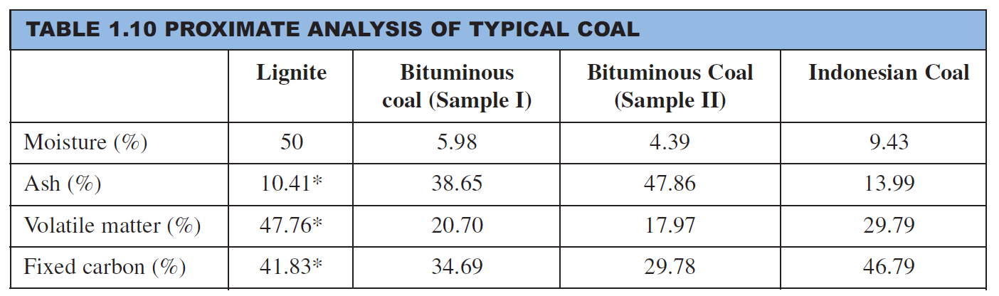
(c) Blending of Coal
In case of coal lots having excessive fines, it is advisable to blend the predominantly lumped coal with lots containing excessive fines.
Coal blending may thus help to limit the extent of fines in coal being fired to not more than 25%. Blending of different qualities of coal may also help to supply a uniform coal feed to the boiler.

Slide 24
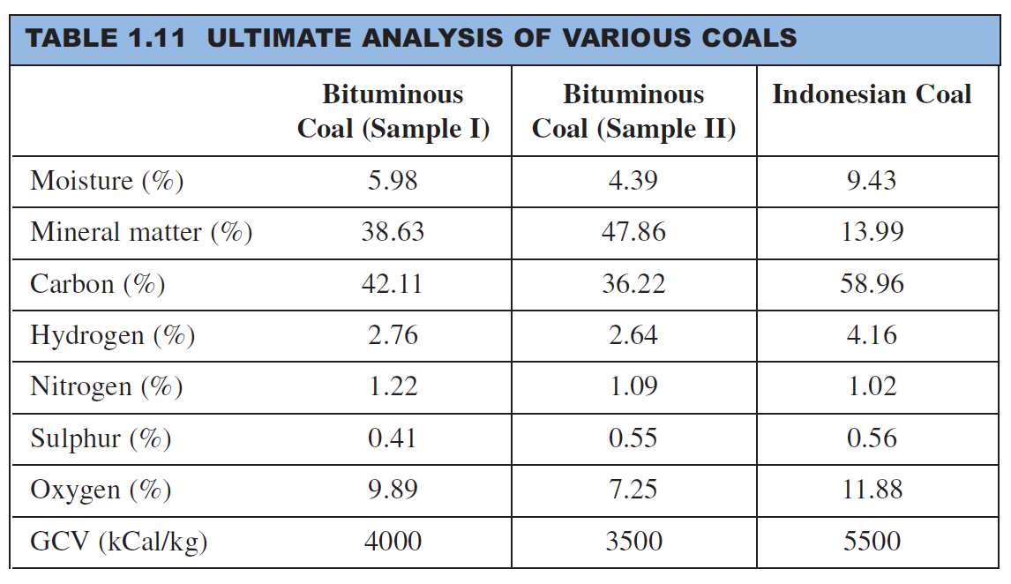

Slide 25
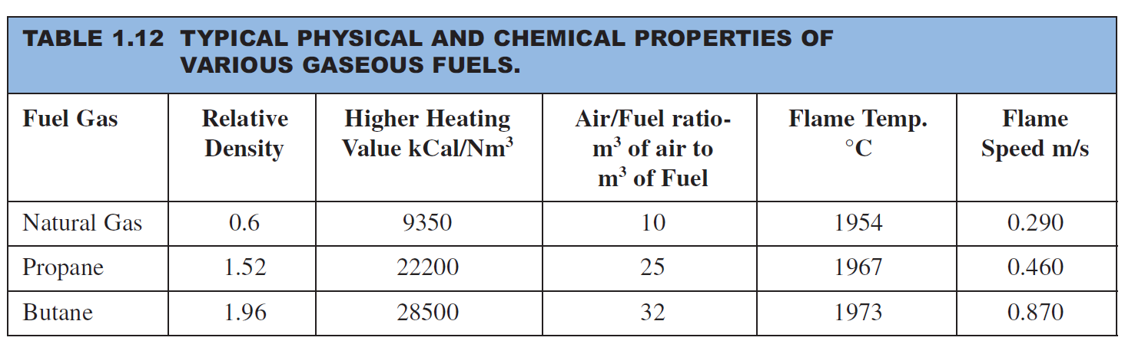
Properties of Gaseous Fuels
Gaseous fuels in common use are liquefied petroleum gases (LPG), Natural gas, producer gas, blast furnace gas, coke oven gas etc.
The calorific value of gaseous fuel is expressed in kCal/Nm³ at normal temperature (20°C) and pressure (760 mm Hg).
Fuel should be compared based on the NCV. This is especially true for natural gas, since increased hydrogen content results in high water formation during combustion.

Slide 26
LPG is a predominant mixture of propane & Butane with a small % of unsaturated (Propylene and Butylene) and some lighter C₂ as well as heavier C₅ fractions. Included in the LPG range are propane (C₃H₈), Propylene(C₃H₆), normal and iso-butane (C₄H₁₀) and Butylene(C₄H₈).
LPG defined as those hydrocarbons, which are gaseous at normal atmospheric pressure, but may be condensed to the liquid state at normal temperature, by the application of moderate pressures.
Although they are normally used as gases, they are stored and transported as liquids under pressure for convenience and ease of handling.
LPG vapour is denser than air, butane is @ 2 times heavy as air & propane about @1.5 times heavy as air.
Escape of even small quantities of the liquefied gas can give rise to large volumes of vapour / air mixture and thus cause considerable hazard.
To aid in the detection of atmospheric leaks, all LPG’s are required to be odorized. There should be adequate ground level ventilation where LPG is stored

Slide 27
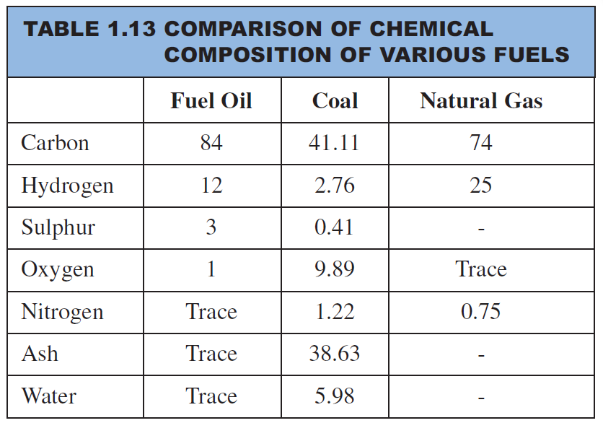
Natural Gas:
Methane is the main constituent of Natural gas and accounting for about 95% of the total volume.
Other components are: Ethane, Propane, Butane, Pentane, Nitrogen, Carbon Dioxide, and traces of other gases like sulphur.
Natural gas is a high calorific value fuel requiring no storage facilities. It mixes with air readily and does not produce smoke or soot. It has no sulphur content. It is lighter than air and disperses into air easily in case of leak.

Slide 28
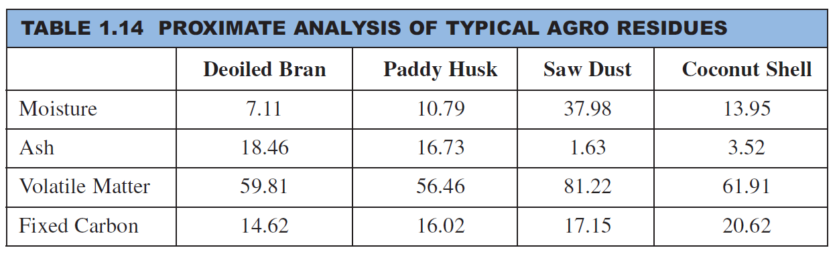
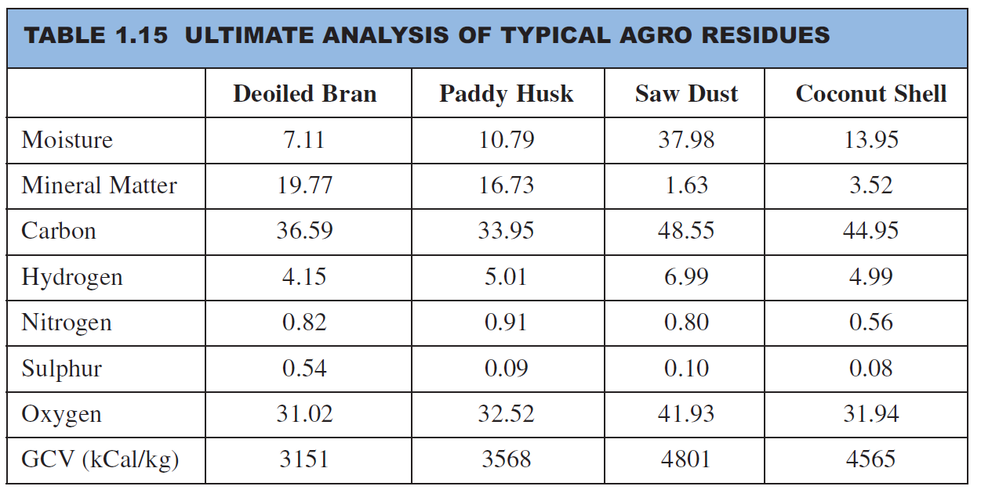
Properties of Agro Residues:
The use of locally available agro residues is on the rise. This includes rice husk, coconut shells, groundnut shells, Coffee husk, Wheat stalk etc.

